Slide 1
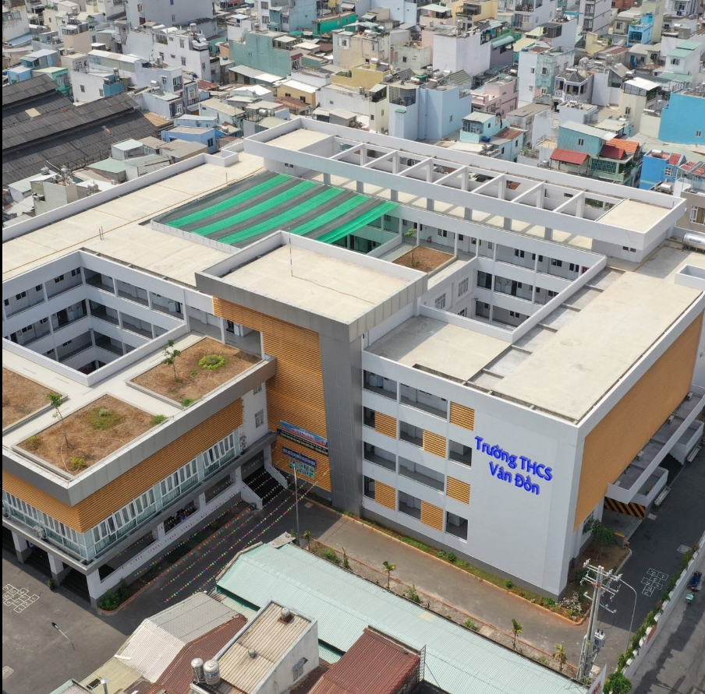
Van Don Secondary School

Slide 2
1. Complete the dialogues. Use the adverbs of manner in the box.
softly
well
fast
badly
hard
a/ Hoa: Does Mrs. Nga speak English?
Lan: Oh,yes. She speaks English (0) _________.
b/ Hoa: Ba always gets excellent grades.
Lan: That’s because he studies (1) _________.
c/ Hoa: That’s our bus!
Lan: Run (2) _______ and we might catch it.
d/ Hoa: I’m very sorry. I know I behaved (3) __________.
Lan: It’s all right.
e/ Hoa: I can’t hear you, Lan.
Lan: Sorry, but I’m speaking (4) __________ because I have a sore throat.

Slide 3
2/ Work with a partner. Look at the picture of Mr. Hao's house. Use the words in the box. Say what he should do.
repair paint cut replant mend

Slide 4
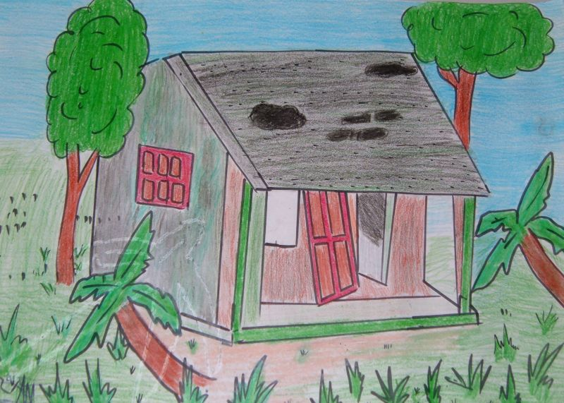
What was wrong with Mr. Hao’s house?
The roof
?
?
?
?
The wall
The door
?
The trees
The grass
?

Slide 5
2. What should Mr. Hao do?
repair
paint
cut
replant
mend
Mr. Hao should repair the roof.
The roof
Mr. Hao should paint the wall.
The wall
The door
Mr Hao should mend the door.
Mr. Hao should replant the tree.
The grass
The trees
Mr. Hao should cut the grass.

Slide 6
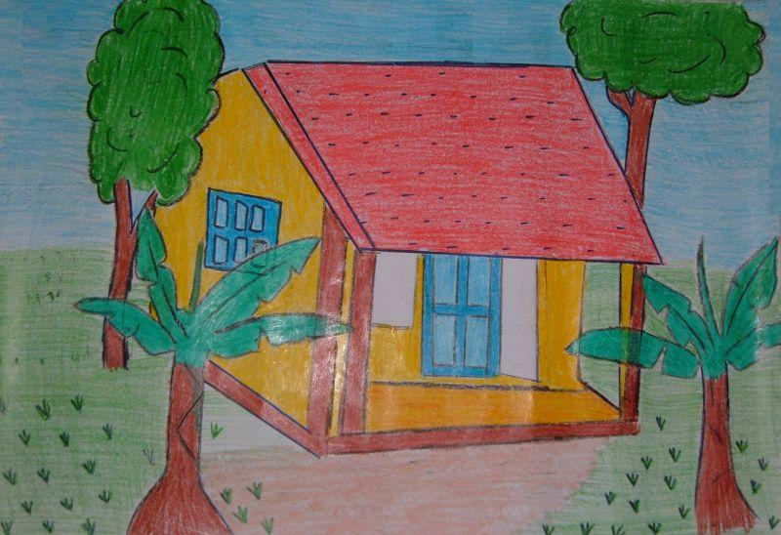
And now, Mr. Hao has a new house.

Slide 7
3/ Work with a partner. Suppose you are Tim's mother. Report Miss Jackson's commands and request in her conversation with Tim's mother.
a/ “Please wait for me outside my office”
→Miss Jackson asked me to wait for her outside her office.
b/ “Please give him his report card for this semester”
→Miss Jackson told me to give you your report card for this semester.
c/ “Can you help Tim with his Spainish pronounciation?”
→Miss Jackson told me to help you with your Spanish pronunciation.
d/ “Can you meet me next week?”
→Miss Jackson asked me to meet her next week.

Slide 8
4/ Work with a partner. Report Miss Jackson's advice she gave in her conversation with Tim's mother.
a/ “Tim should spend more time on Spanish pronounciation.”
→Miss Jackson said you should spend more time on Spanish pronunciation.
b/ “Tim should practice speaking Spanish every day.”
→Miss Jackson said you should practice speaking Spanish every day.
c/ “Tim should listen to Spaninsh conversations on TV.”
→Miss Jackson said you should listen to Spanish conversations on TV.
d/ “Tim should practice reading aloud passages in Spanish.”
→Miss Jackson said you should practive reading aloud passages in Spanish.
e/ “Tim should use this dictionary to find out how to pronounce Spanish words.”
→Miss Jackson said you should use this dictionary to find out how to pronounce Spanish words.

Slide 9


Good bye, see you later !

